Slide 1
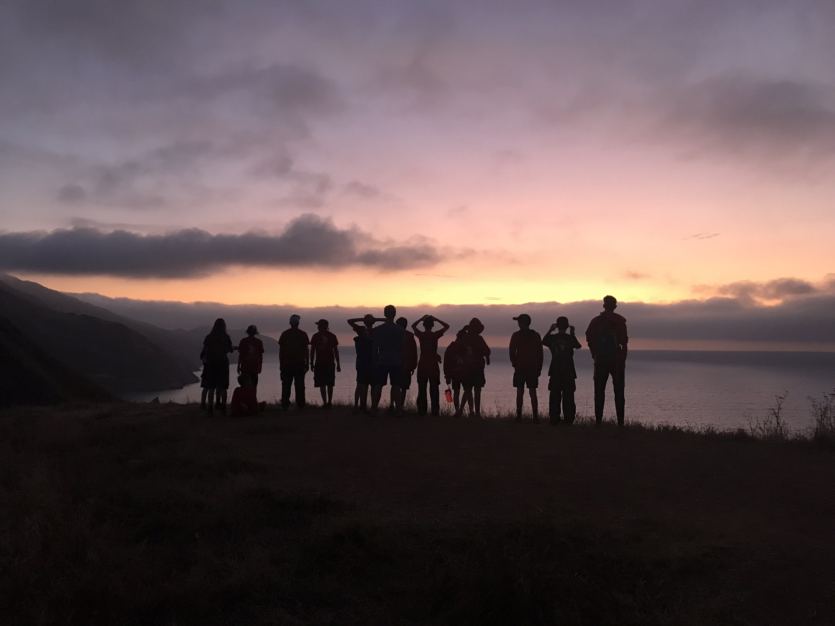
Troop 146
Summer Camp 2026

Slide 2
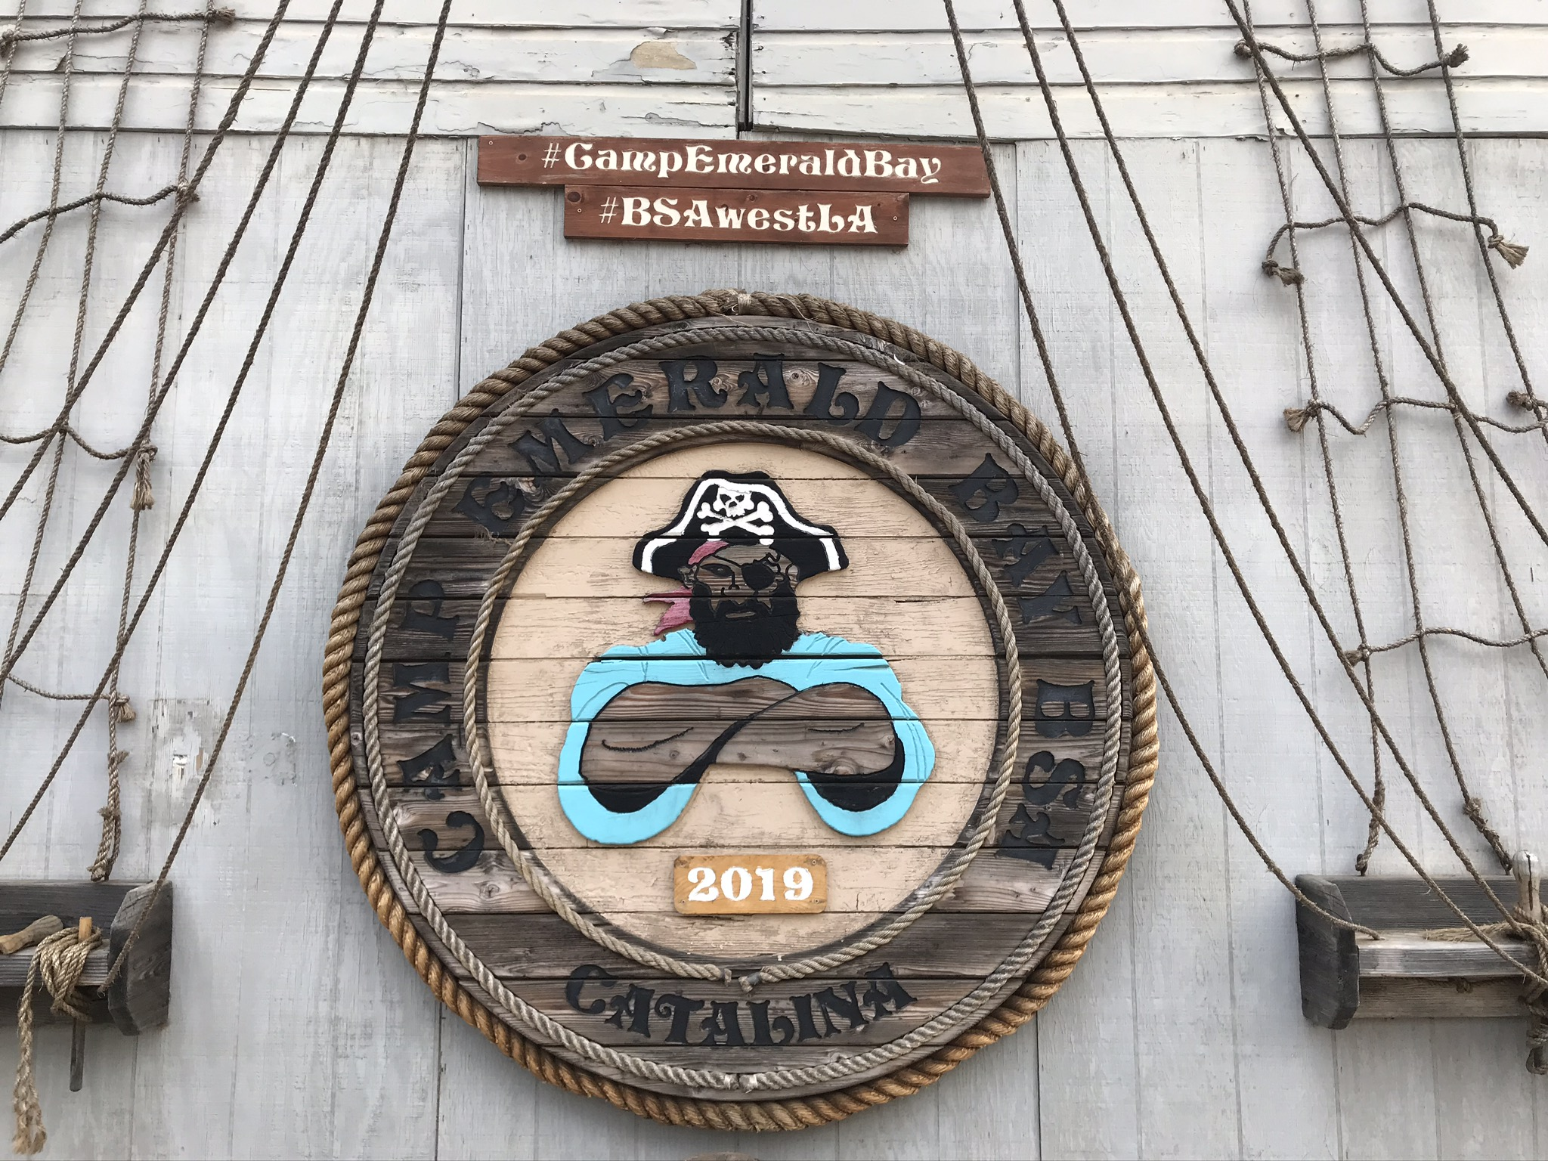
Camp Emerald Bay
Where, Why, When & What!

Slide 3
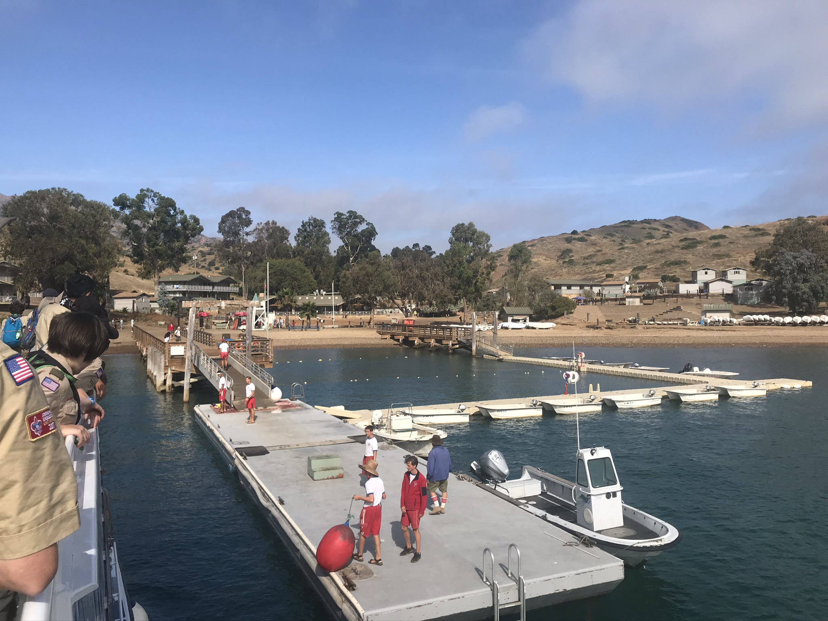
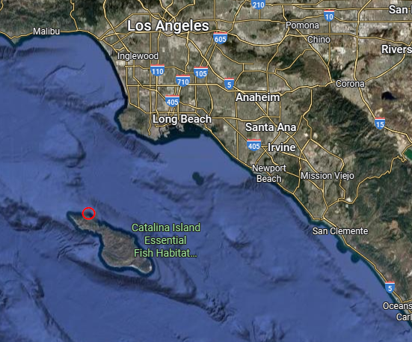
Camp Emerald Bay
Where, Why, When & What!
Camp Emerald Bay is located on the North end of Catalina Island off the coast of California, Southwest of Los Angeles.

Slide 4
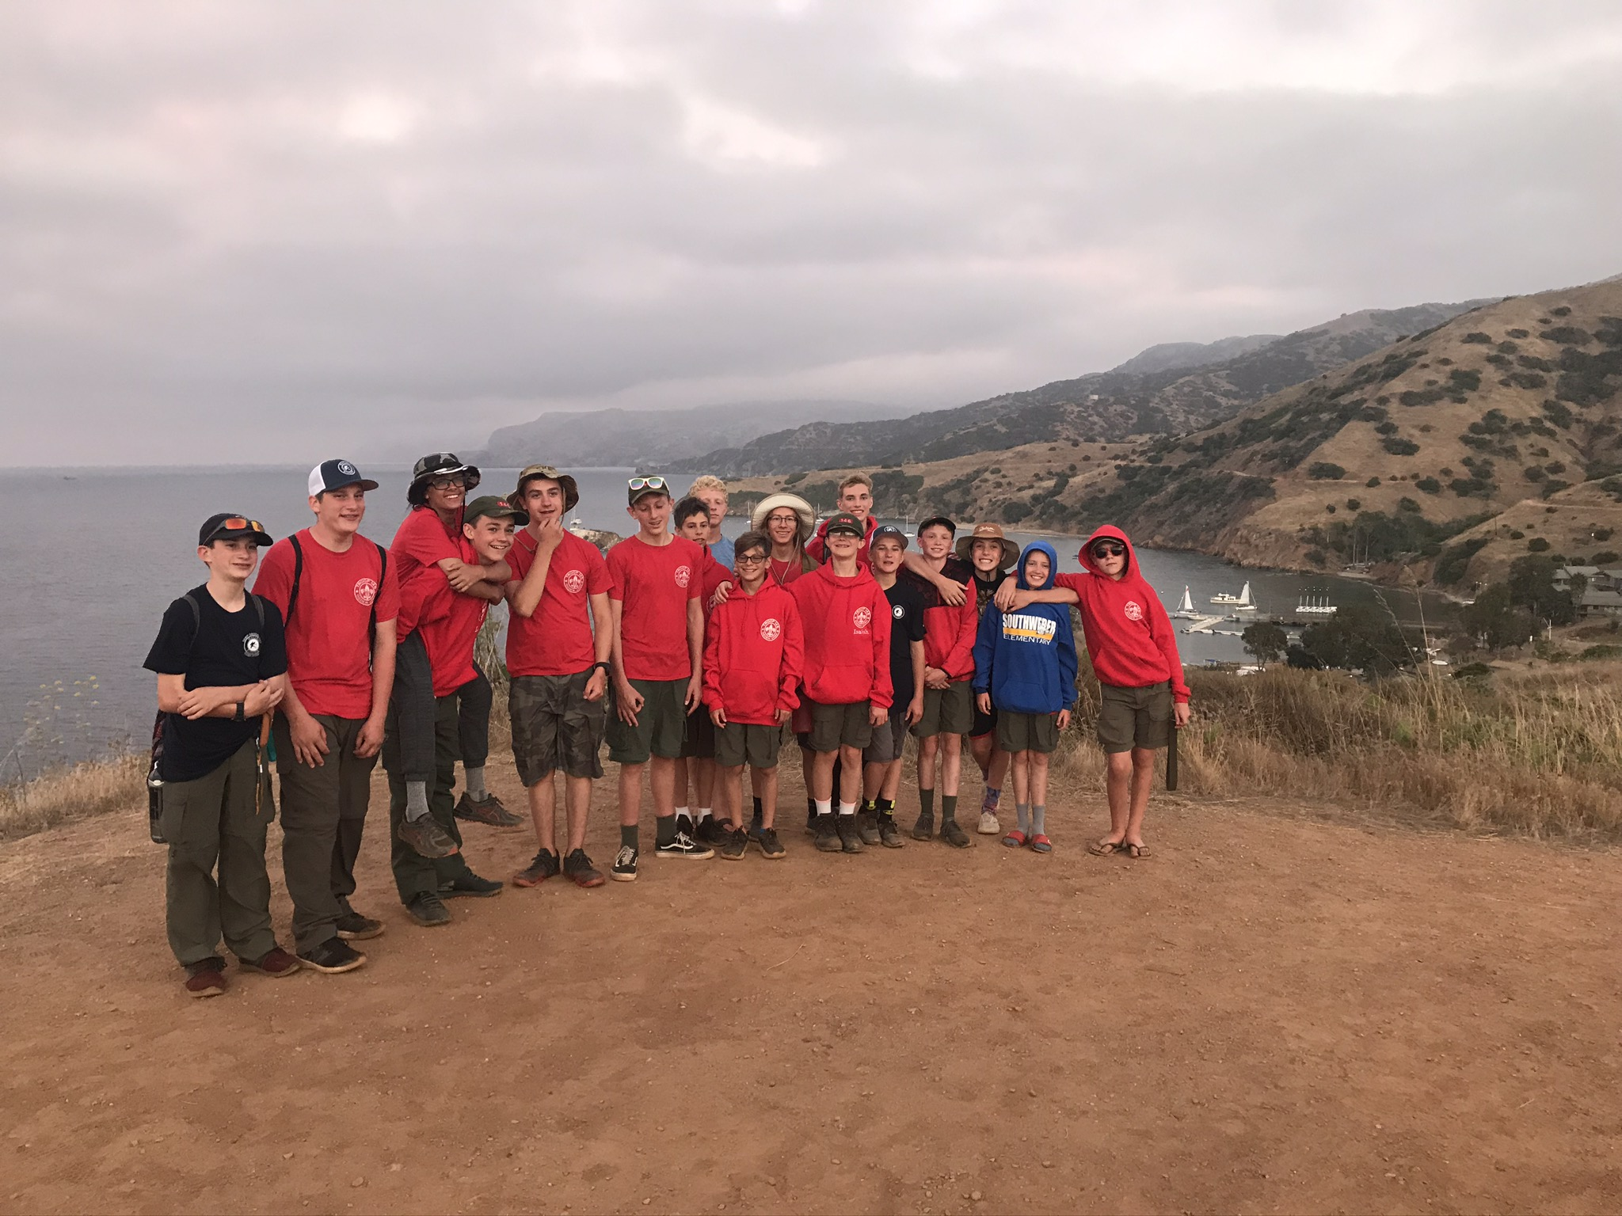
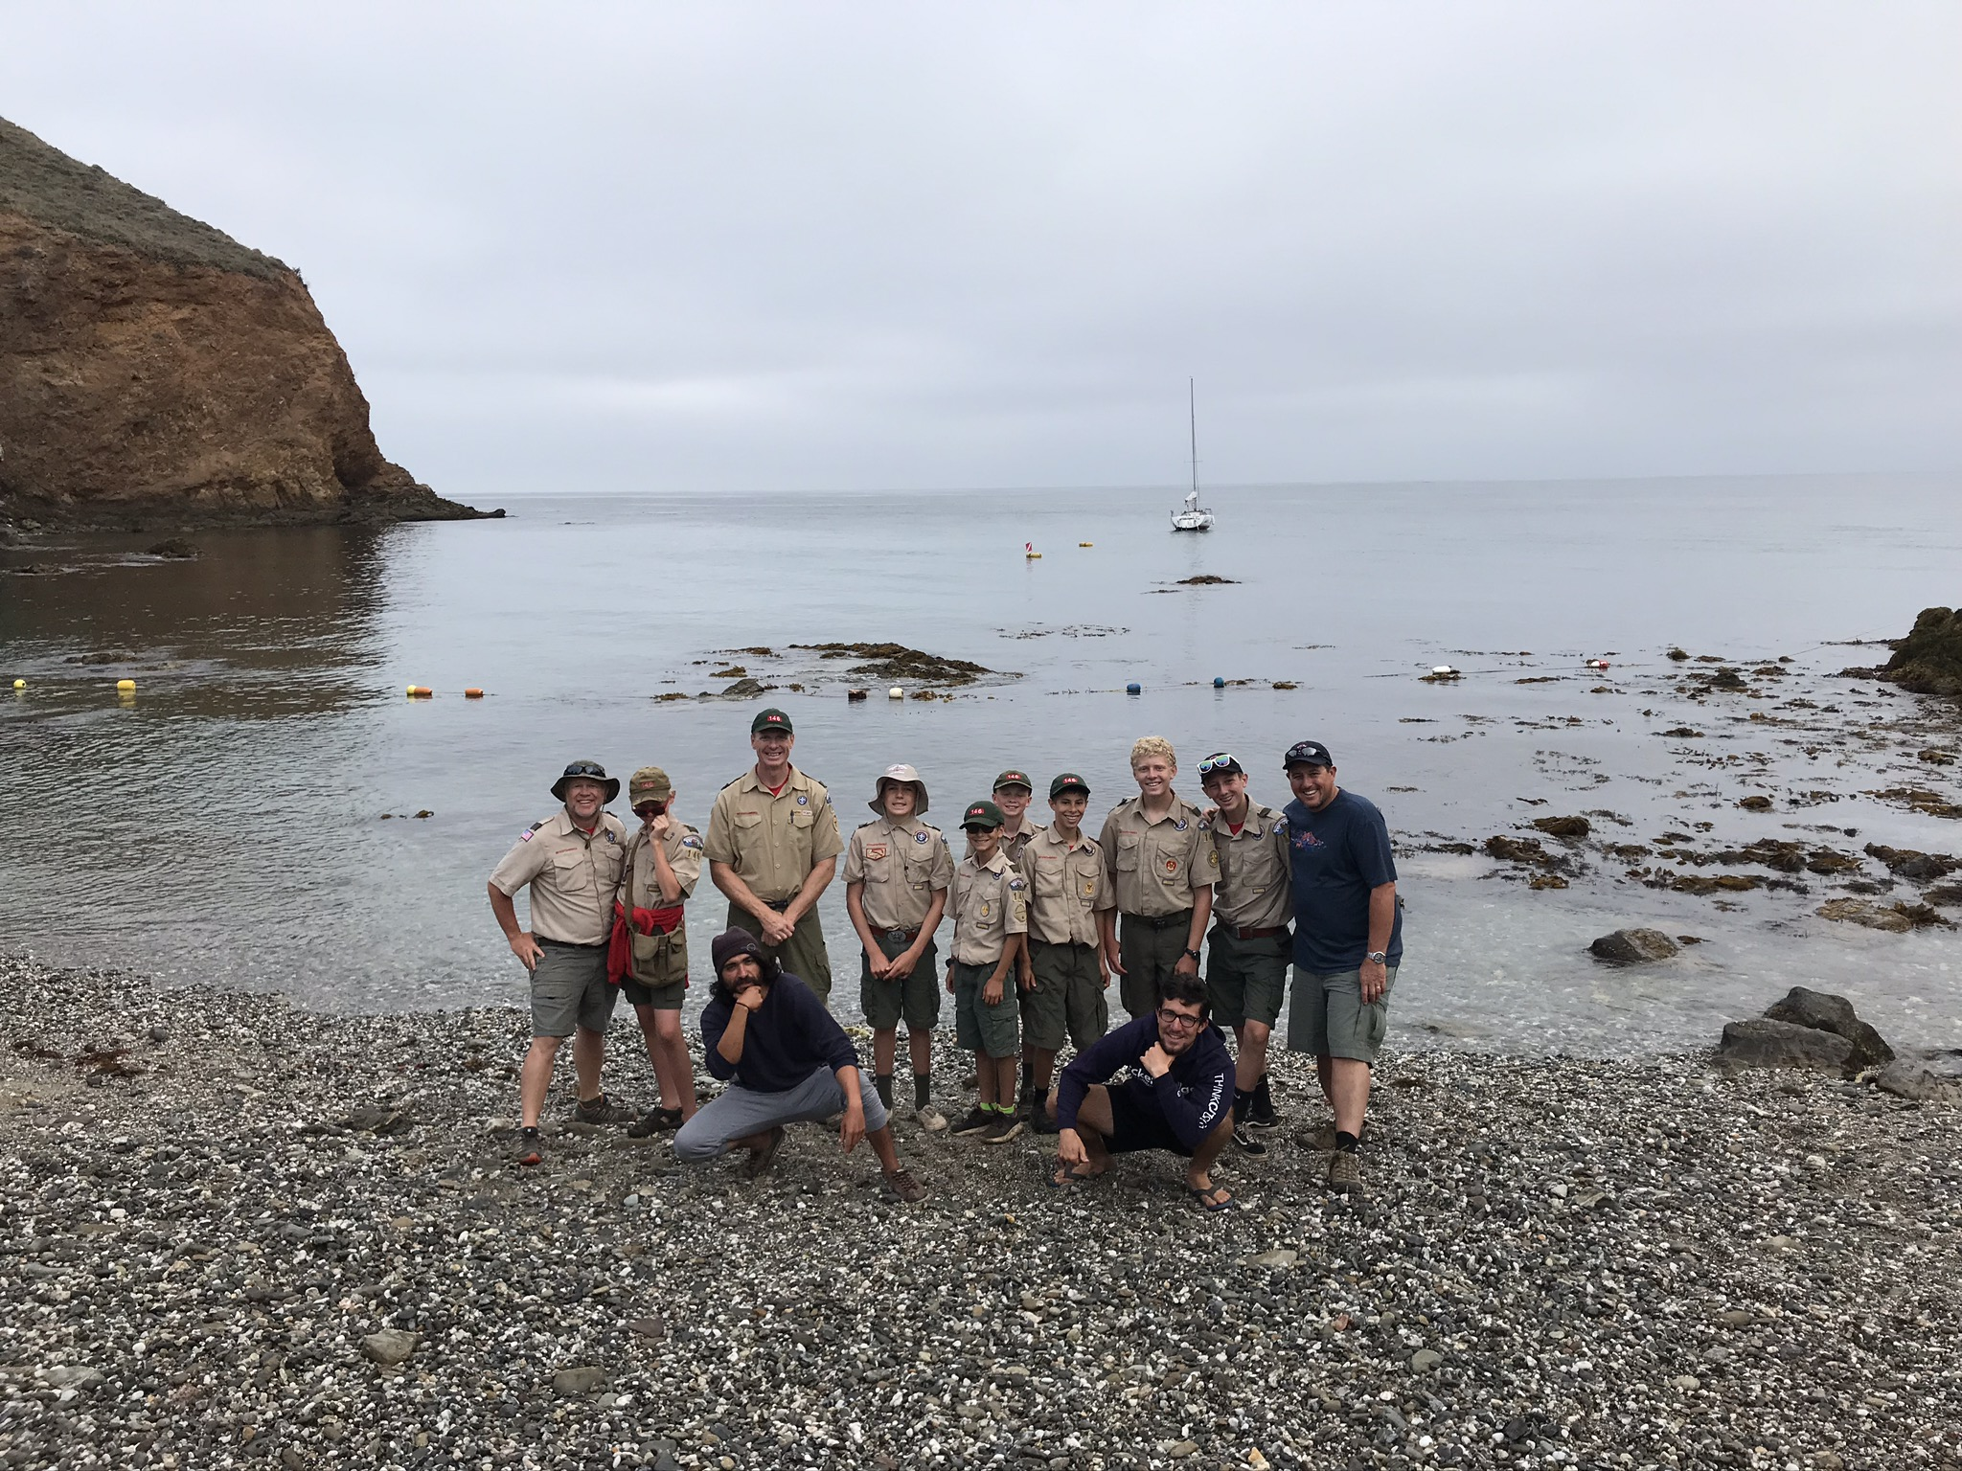
Camp Emerald Bay
Where, Why, When & What!
Troop 146 attended in 2019
Unique Island experience
Great Aquatics Program
Multiple Merit Badge Opportunities
Troop bonding & tradition

Slide 5
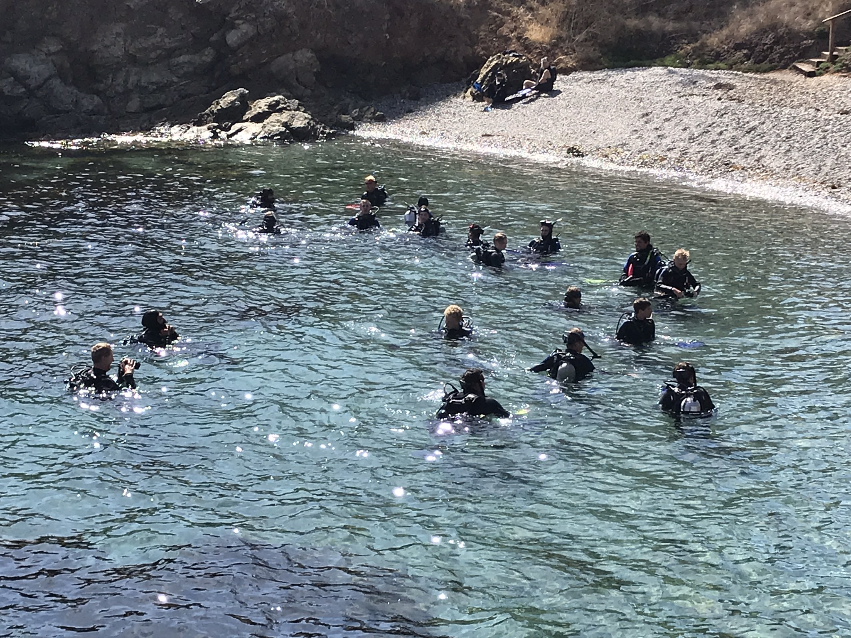
Camp Emerald Bay
Where, Why, When & What!
Some of the Camp Programs available
Traditional Merit Badge Camp
  Over 30 badges offered
  Kayaking, Mountain Biking, Snorkeling, Archery, Rifle, etc.
Scuba Certification Camp
  Open Water Diver Certification
  Earn Scuba Diving merit badge
  Requires pre-camp work
Rugged Adventures
  Explores
  Canoe
  Trek
Other Camp Opportunities:
Night dive
Sunrise/Sunset hikes
Dining Hall
“Discover Scuba Diving”
Free Time
Camp Battleship

Slide 6
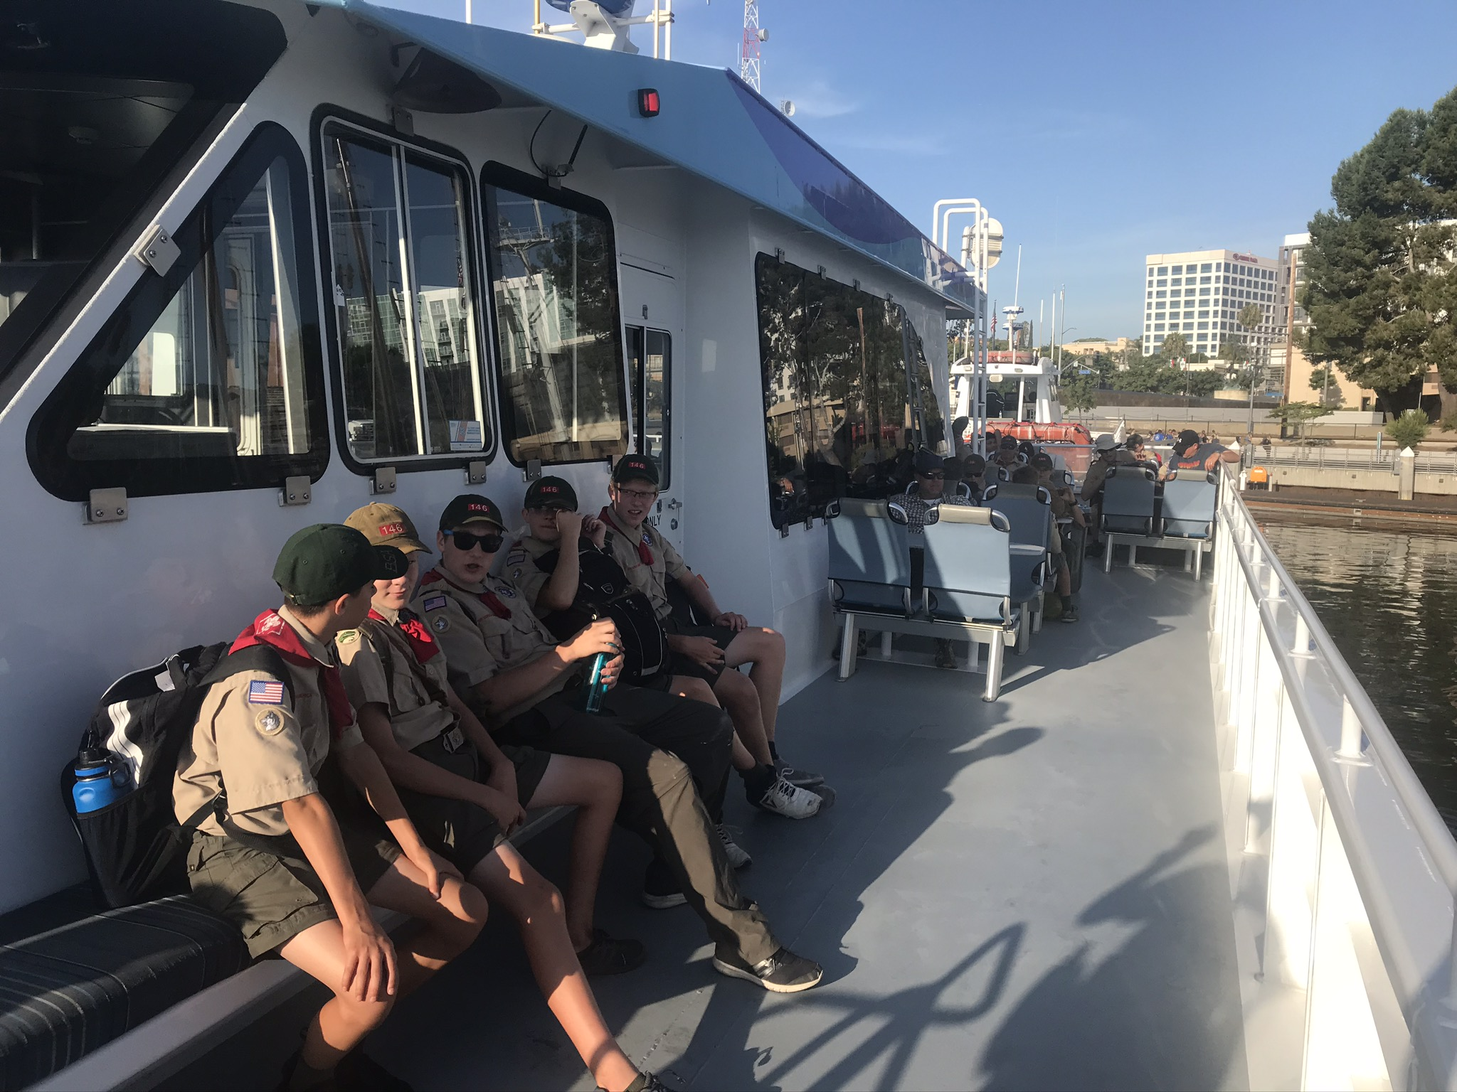
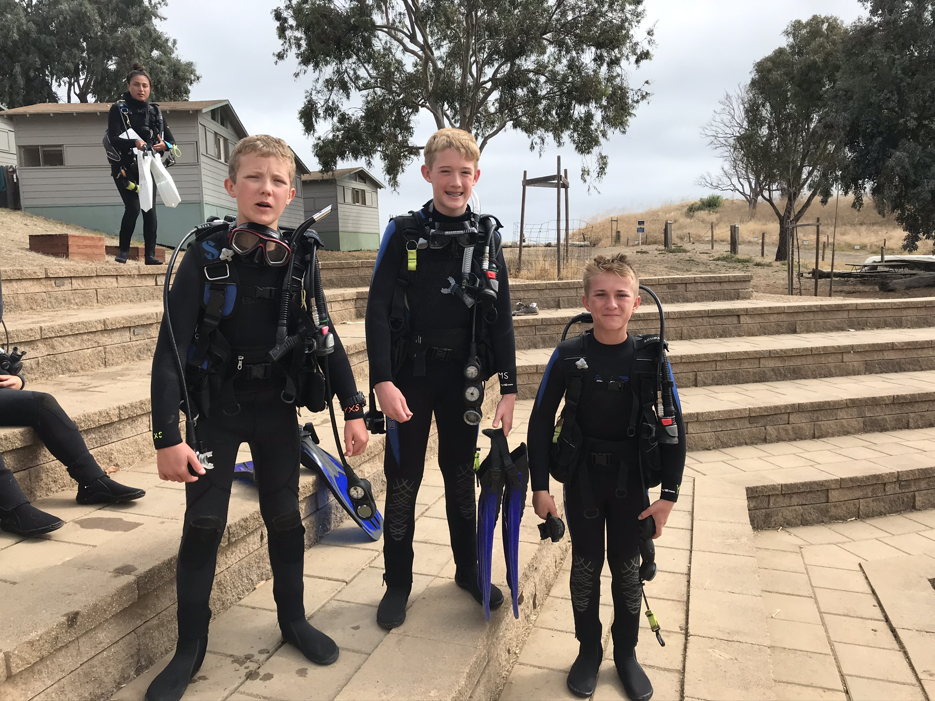
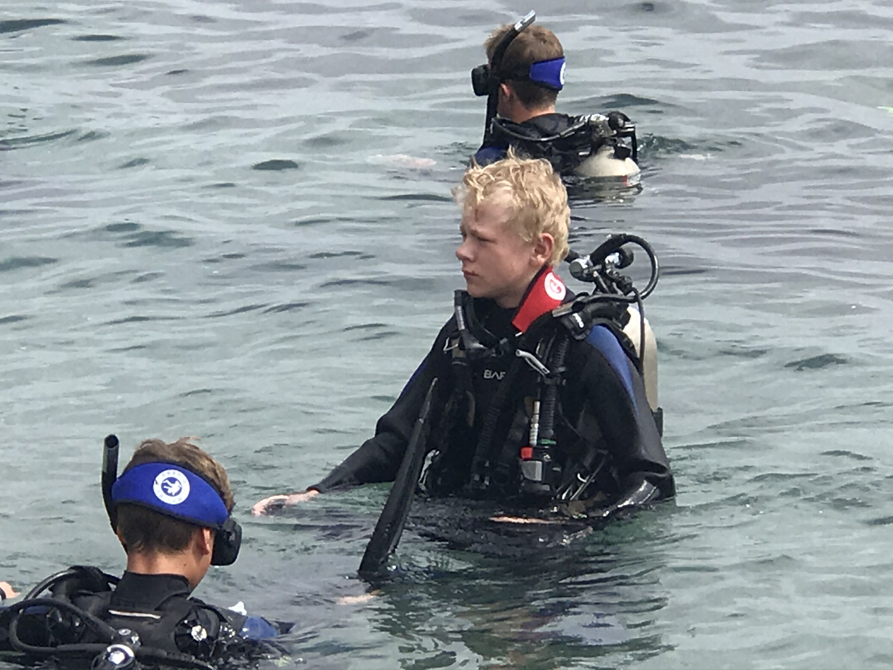
Camp Emerald Bay
Where, Why, When & What!

Slide 7
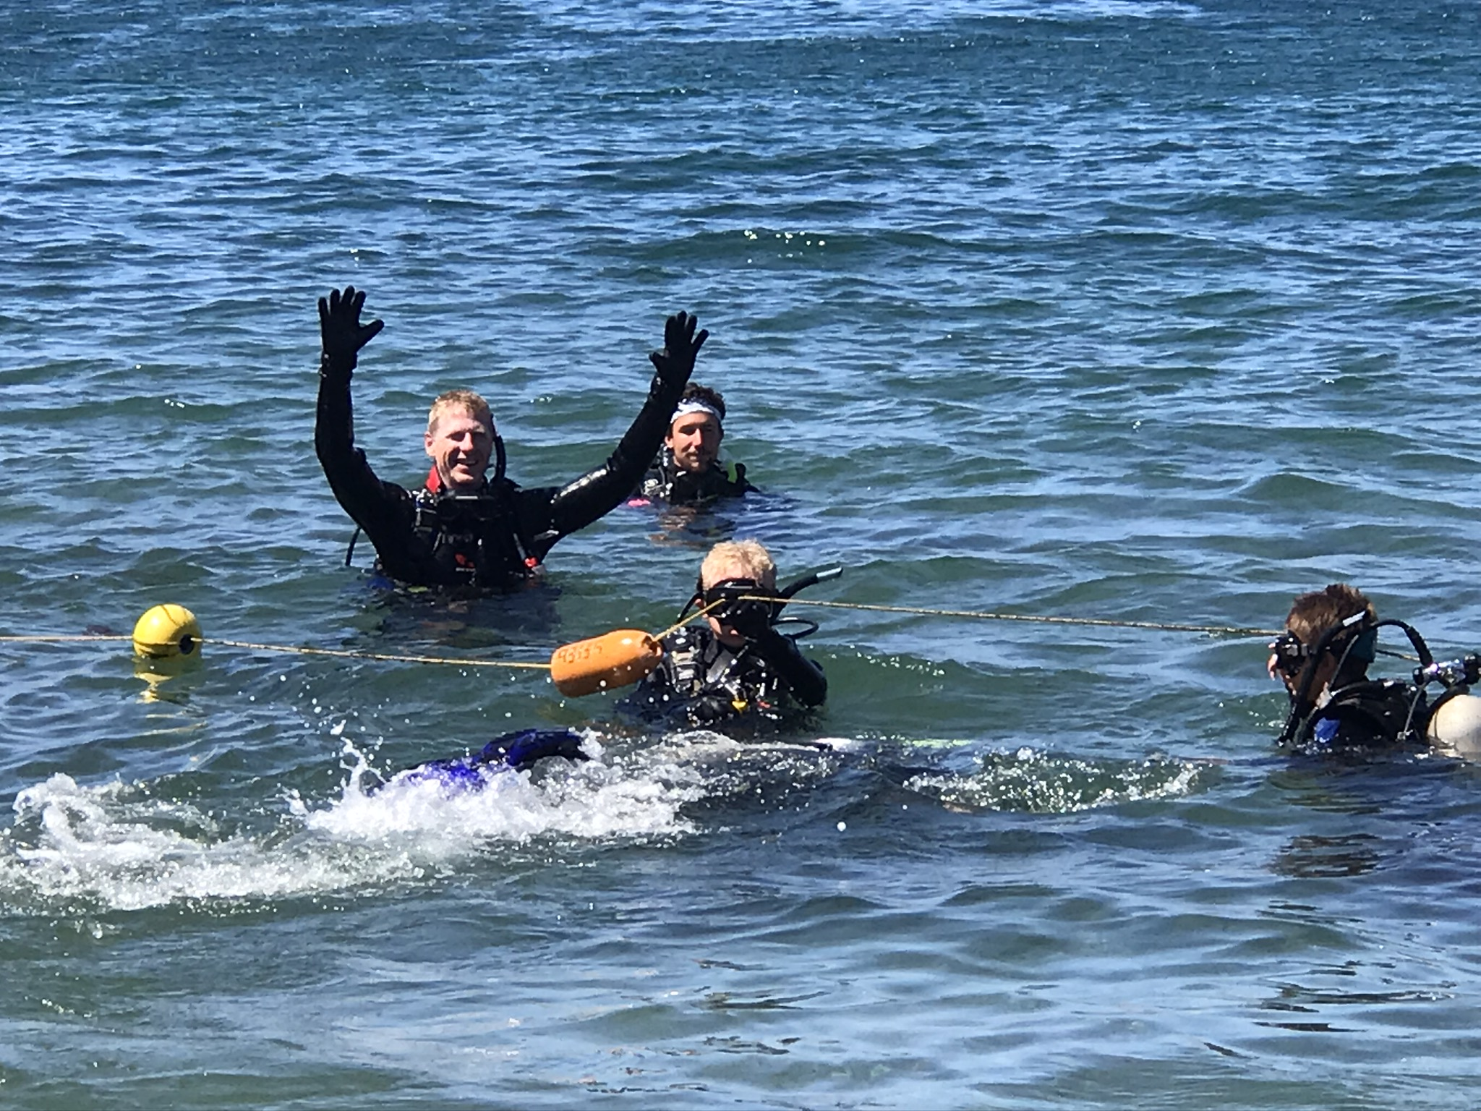
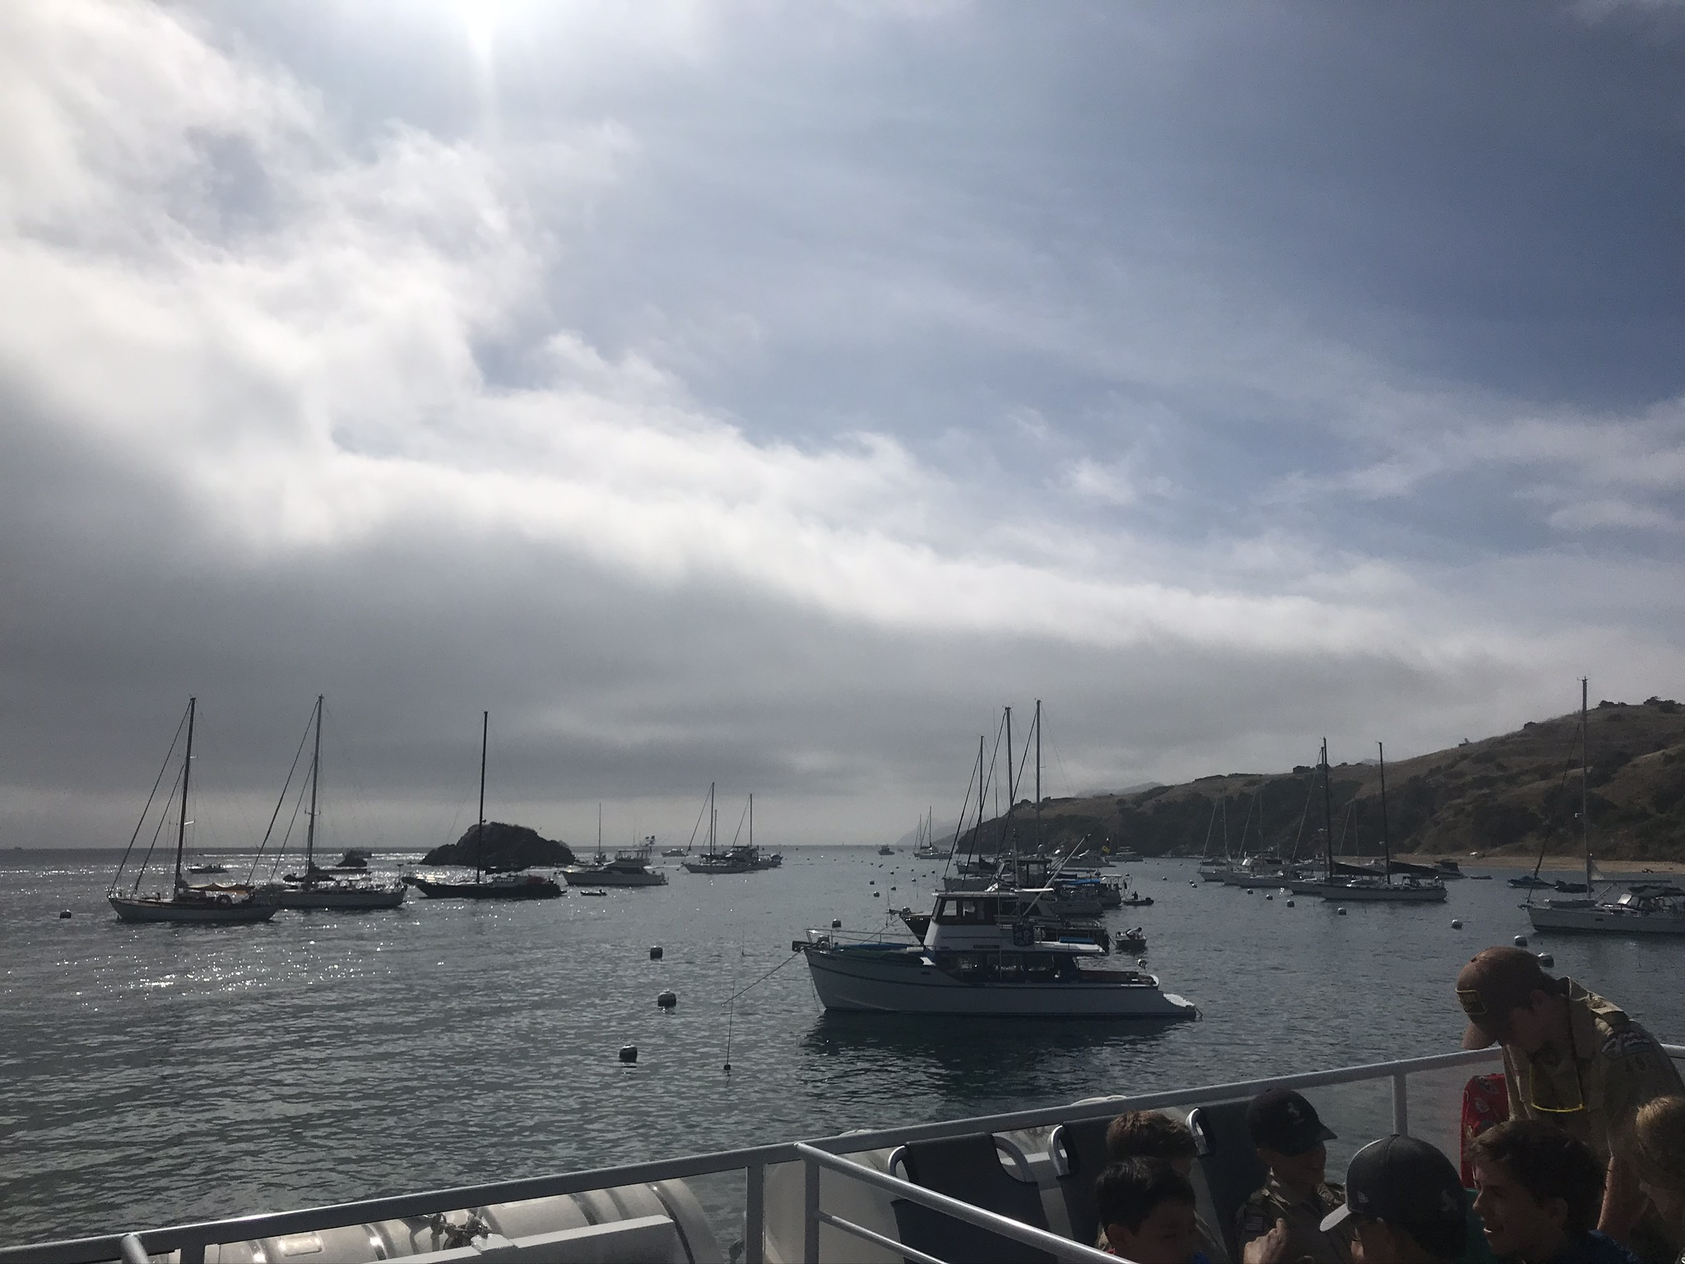
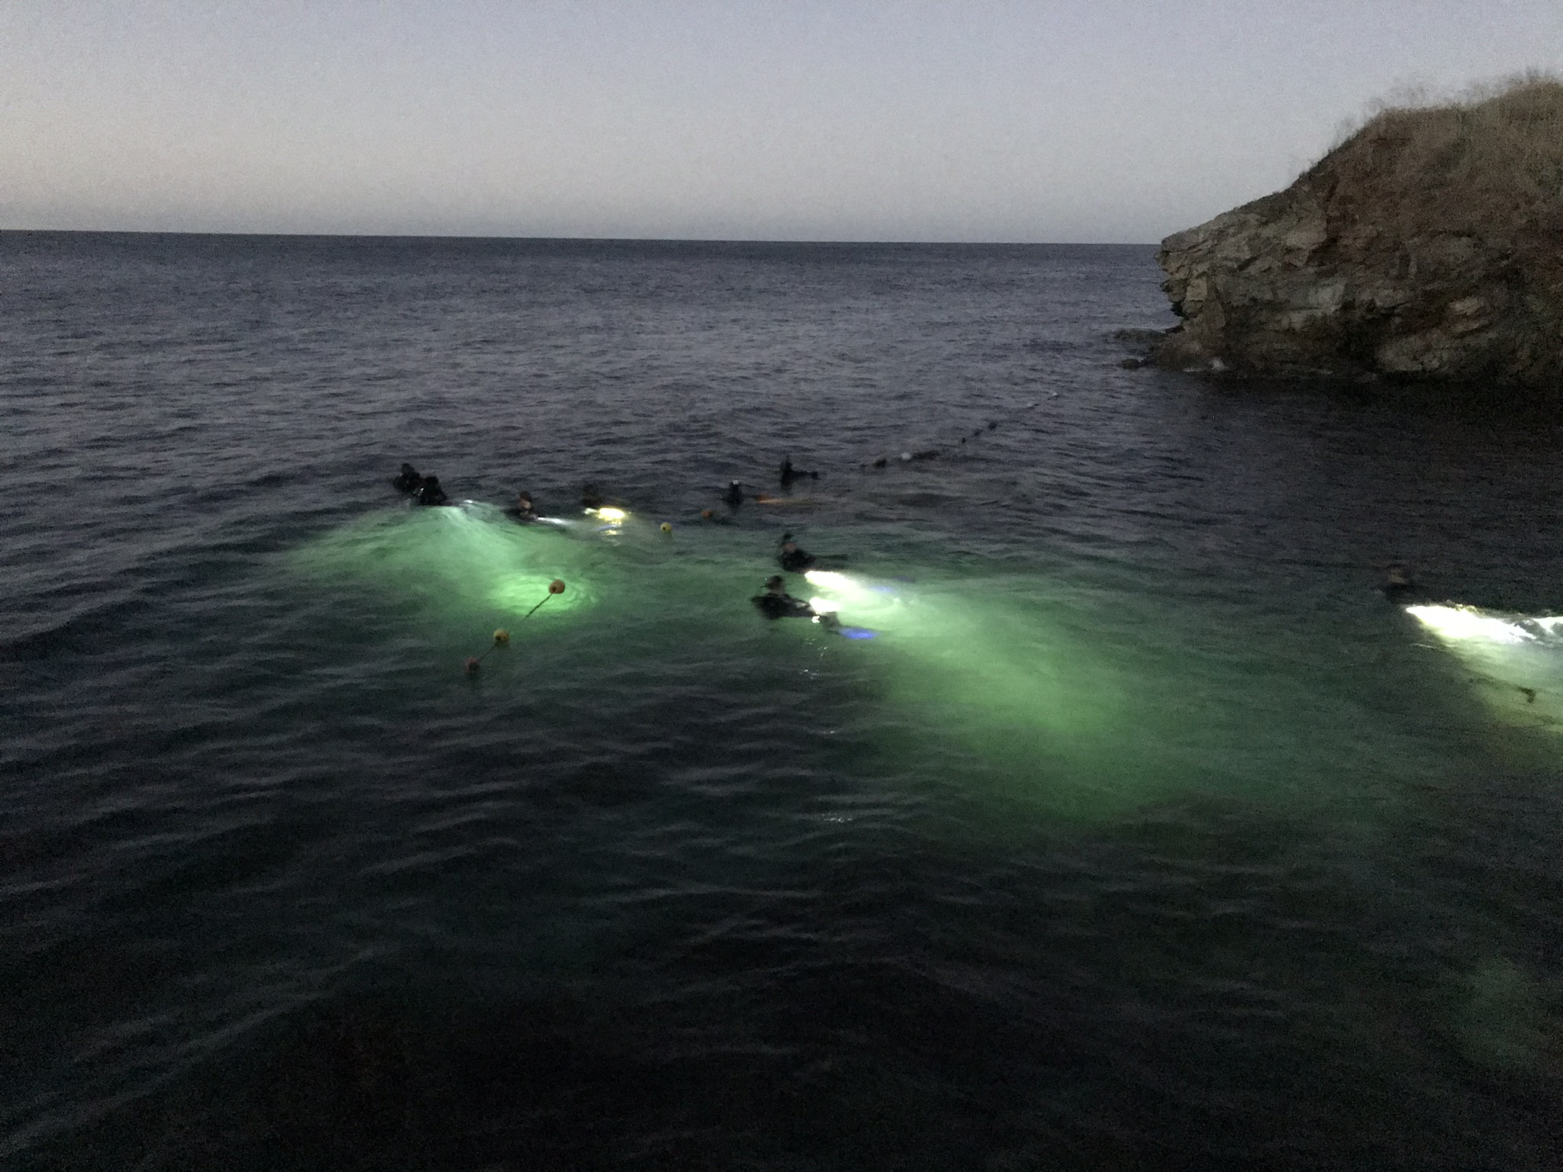
Camp Emerald Bay
Where, Why, When & What!

Slide 8
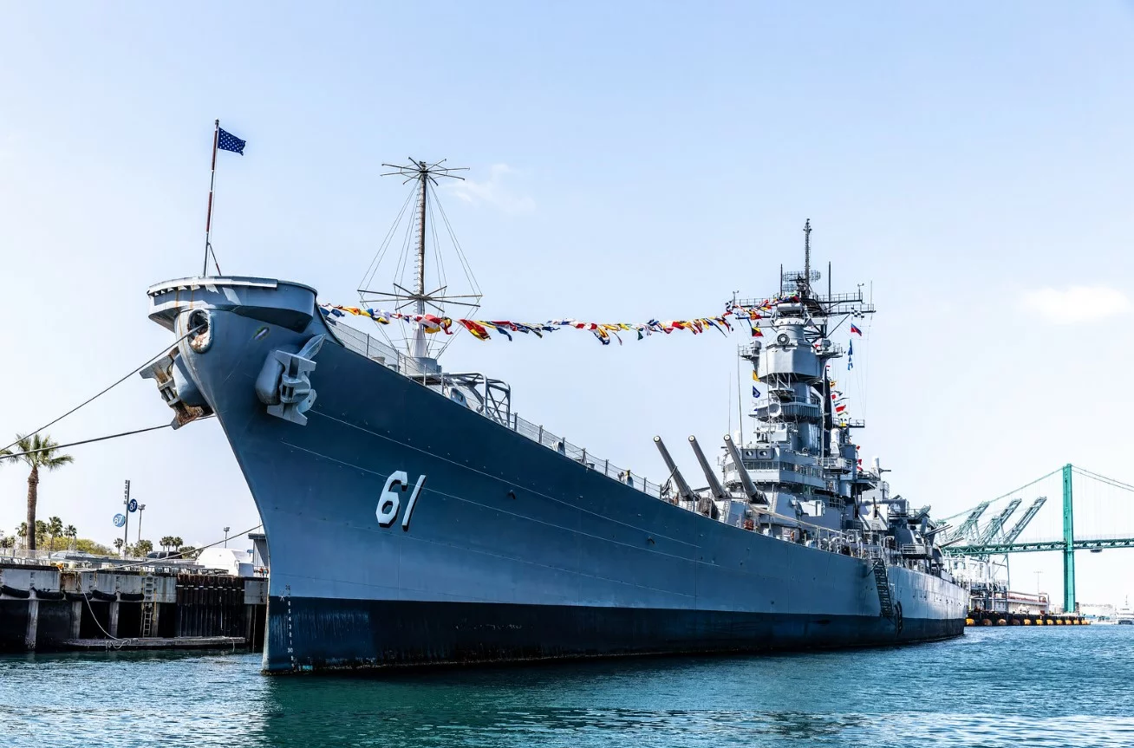
Camp Emerald Bay
Where, Why, When & What!
Camp Battleship
Scouts & Adults get to spend the night on the Battleship Iowa and experience the following:
Eat dinner & breakfast in the ship mess hall
Sleep in the same bunks the sailors did
A tour of the ship including its history
Evening flag ceremony on the ships deck

Slide 9
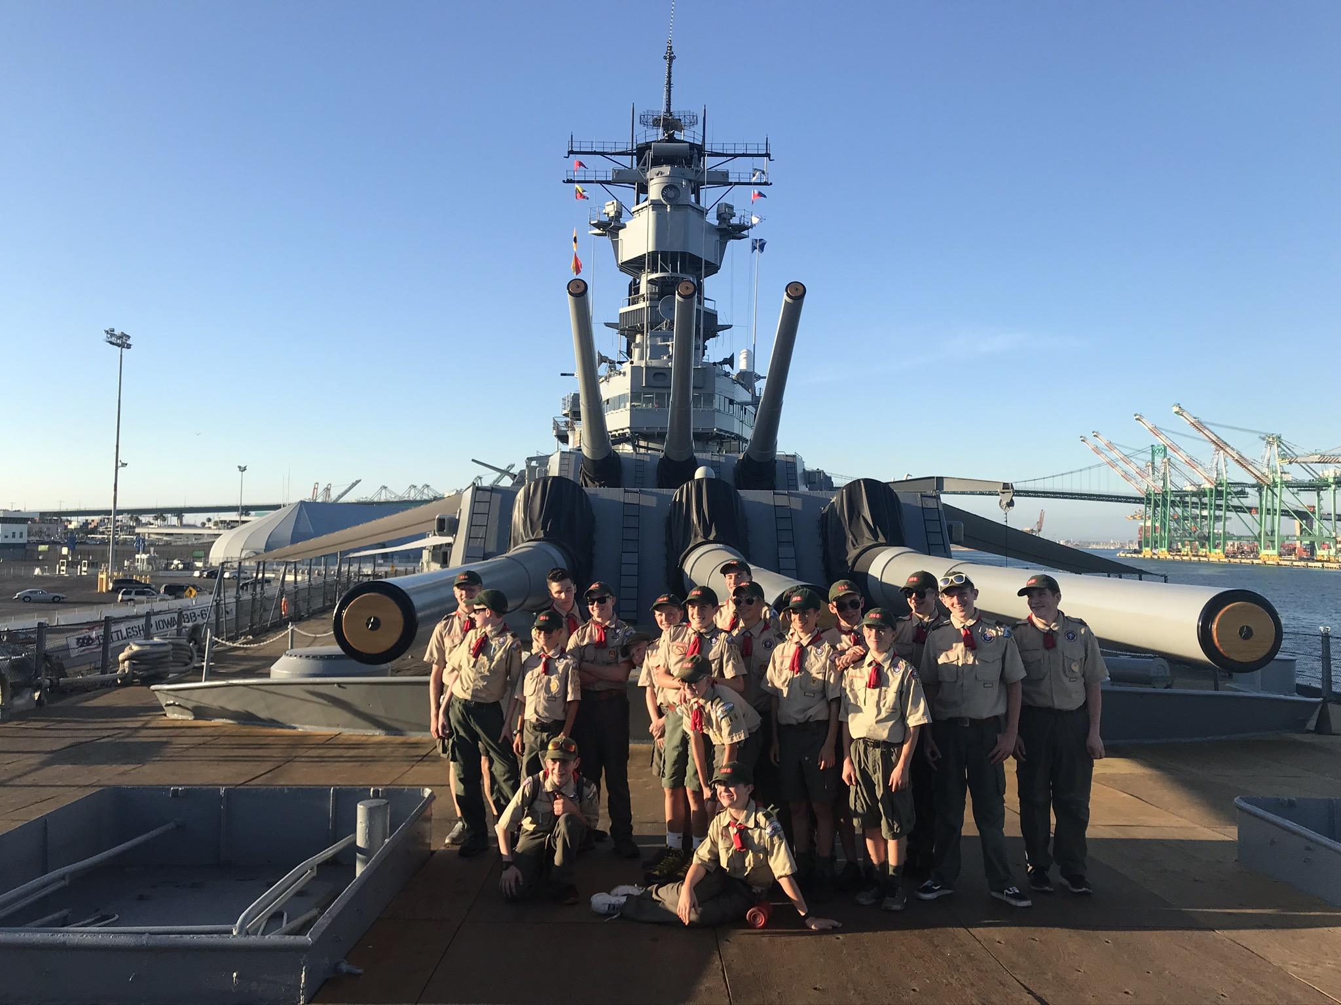
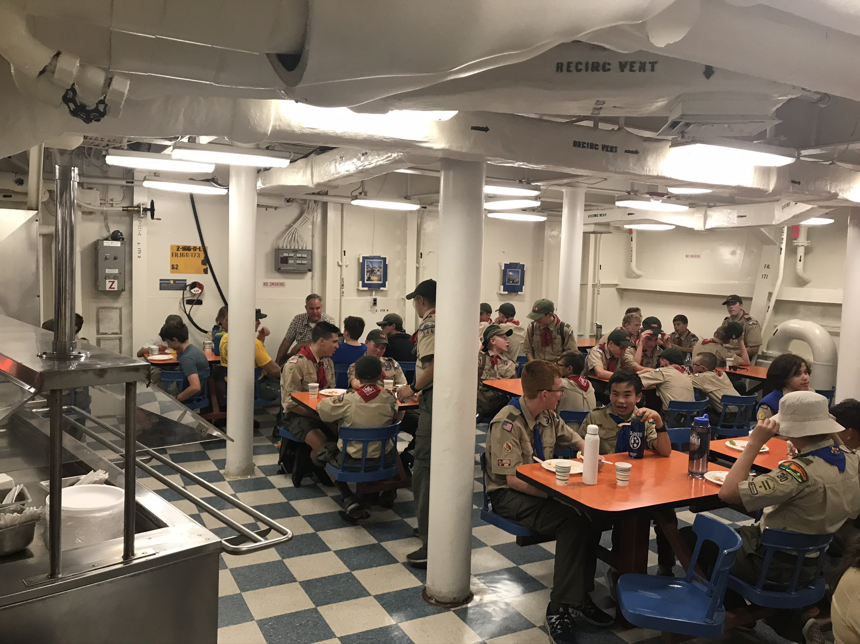
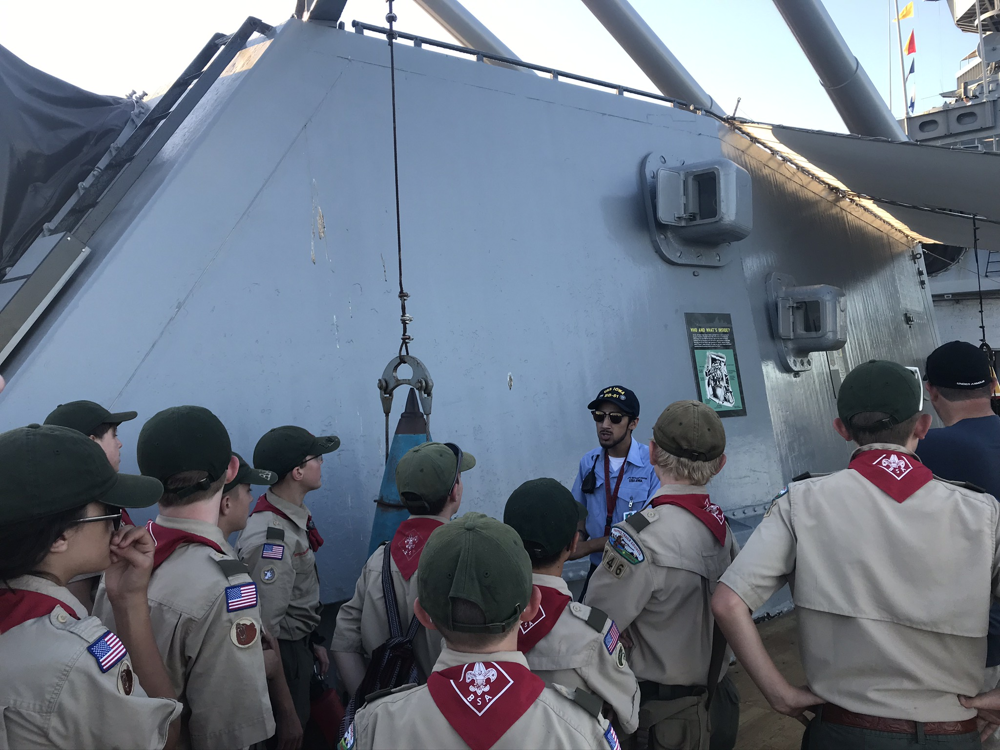
Camp Emerald Bay
Where, Why, When & What!

Slide 10
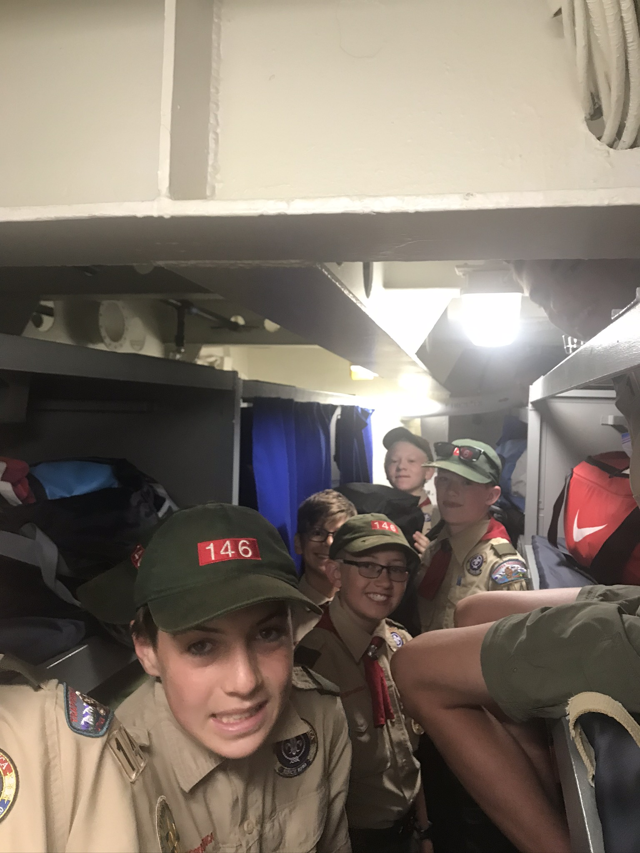
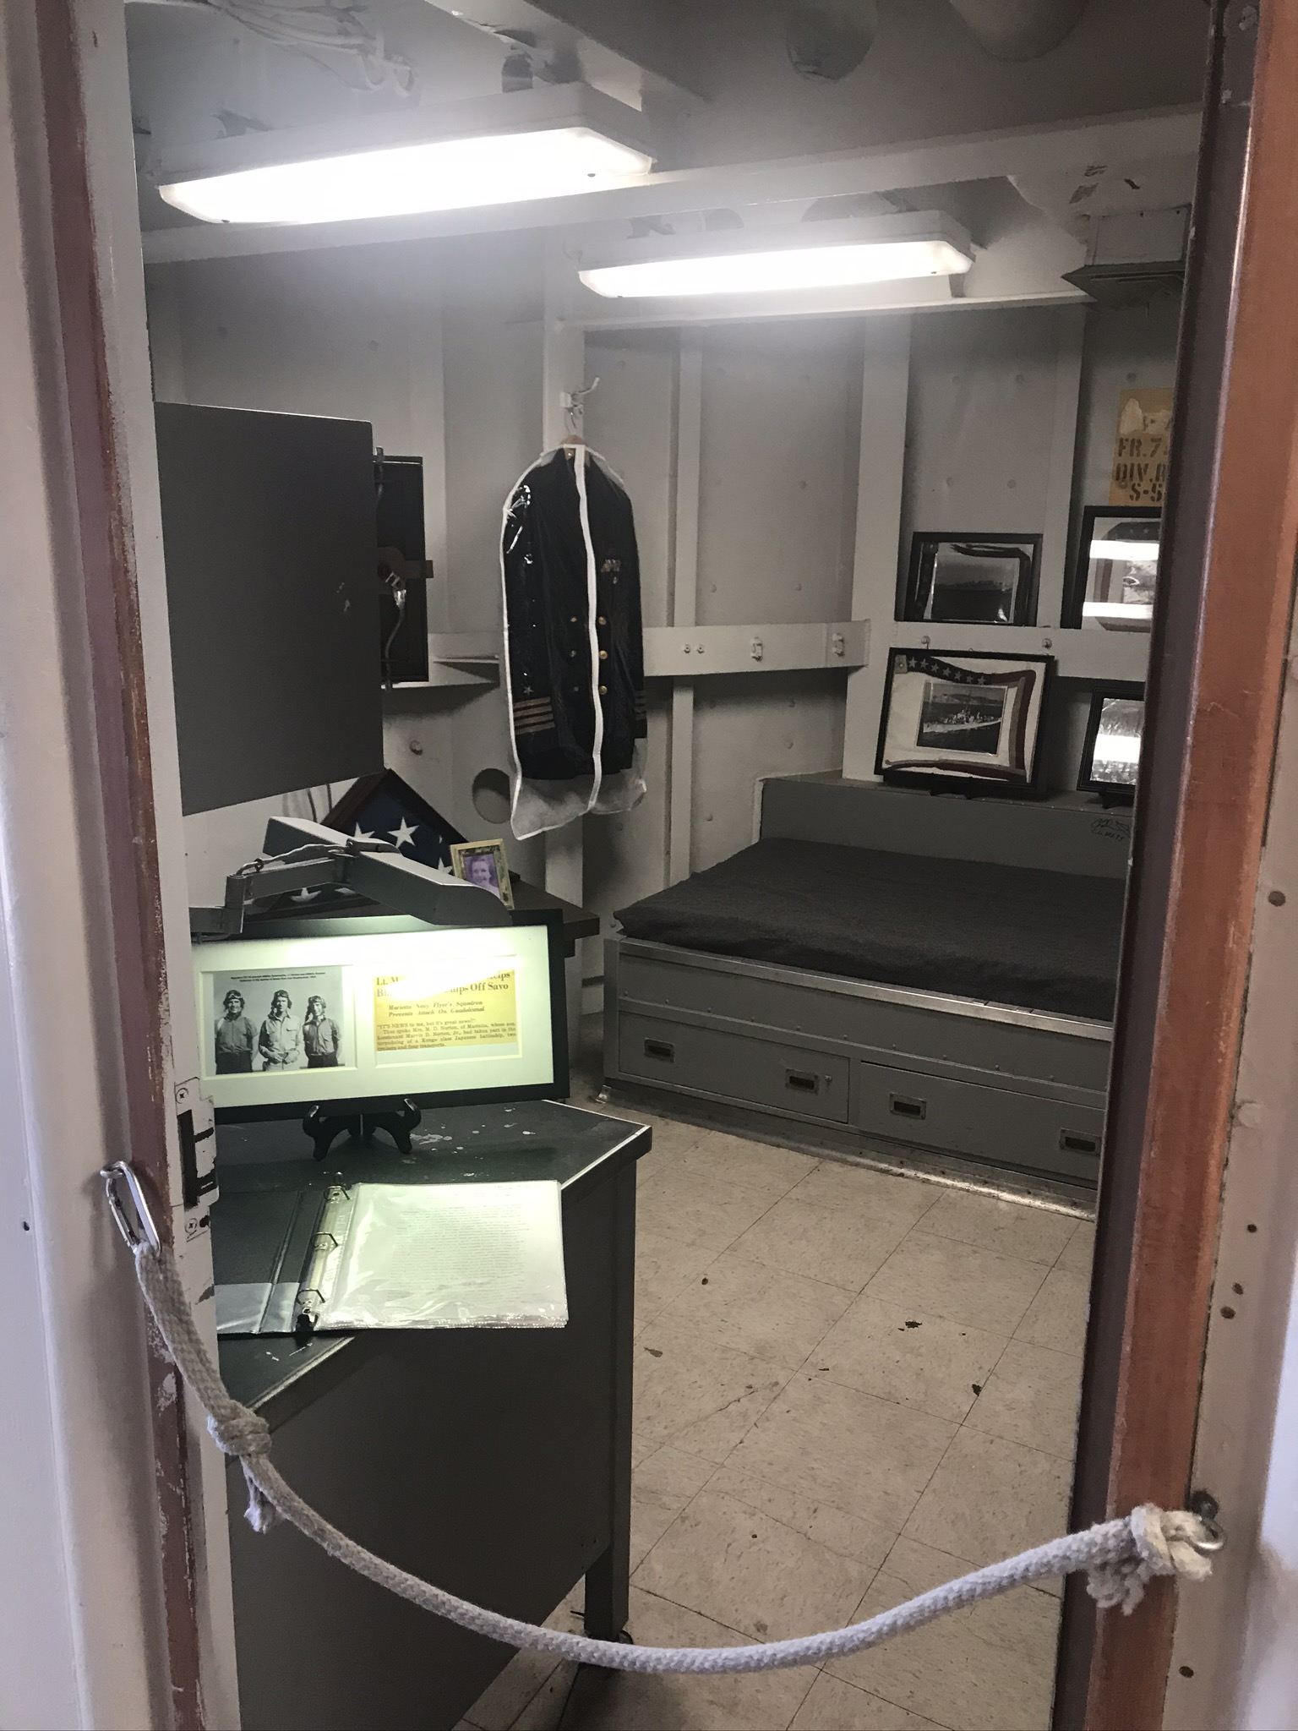
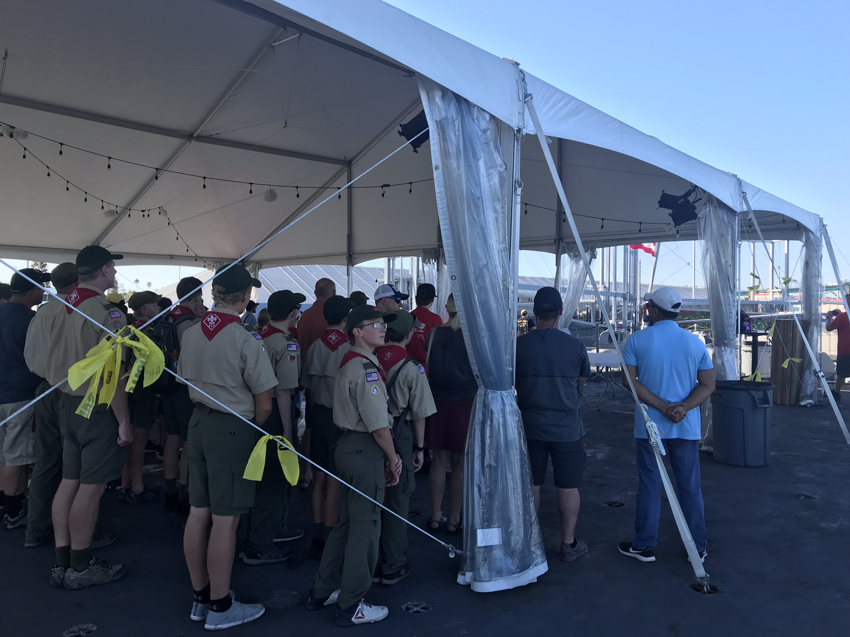
Camp Emerald Bay
Where, Why, When & What!

Slide 11
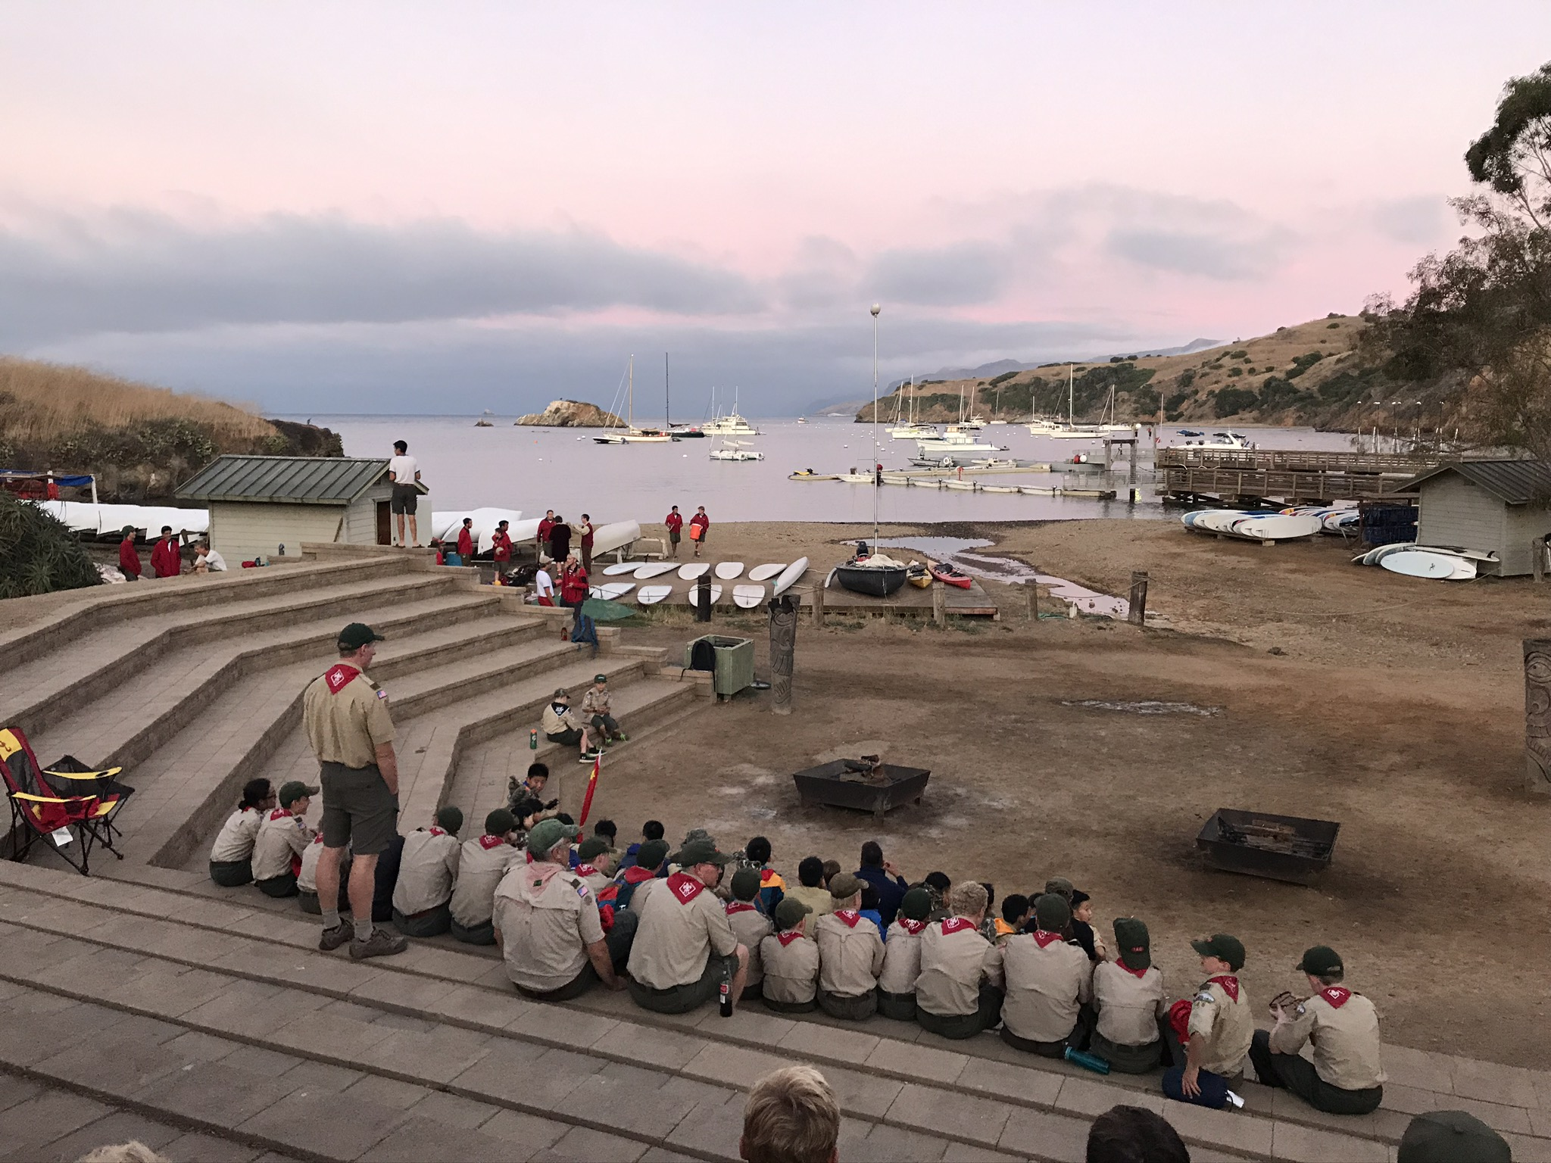
Camp Emerald Bay
Where, Why, When & What!
In 2026, there are 8 weeks available to attend and run from Sunday through Saturday.
June 7th - 13th
June 14th - 20th
June 21st - 27th
June 28th – July 4th
July 5th - 11th
July 12th - 18th
June 19th - 25th
June 26th – August 1st

Slide 12
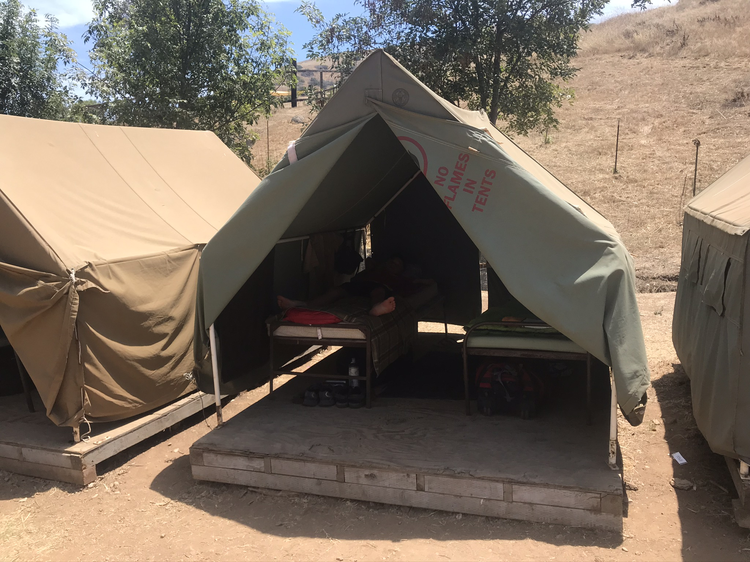
Camp Emerald Bay
Where, Why, When & What!
Example Schedule of Events:
Saturday:
Fly into Los Angeles morning/early afternoon
Shuttle to the Battleship Iowa
Sunday:
Ferry from the LA Harbor to Catalina Island
Get oriented and setup at camp
Monday-Friday:
Camp program
Saturday:
Ferry back to Los Angeles Harbor
Shuttle back to the airport
Fly home late afternoon/early evening

Slide 13
Camp Emerald Bay
Where, Why, When & What Does It Cost!
Traditional Merit Badge Camp
Camp Fees
Camp Battleship
Transportation
Miscellaneous
Scuba Certification Camp
Merit Badge Camp Fee’s
Scuba Certification Fee

Slide 14
Camp Emerald Bay
Where, Why, When & What Does It Cost!
Traditional Merit Badge Camp
Camp Fees
Includes camp, transportation to/from Island and meals:
$1,075 per Scout *
$875 per Adult *
Camp Battleship
Transportation
Miscellaneous
Scuba Certification Camp
Merit Badge Camp Fee’s
Scuba Certification Fee
* Price will increase based on availability

Slide 15
Camp Emerald Bay
Where, Why, When & What Does It Cost!
Traditional Merit Badge Camp
Camp Fees
Camp Battleship
Includes night on ship, dinner/breakfast & tour:
$110 per person
Transportation
Miscellaneous
Scuba Certification Camp
Merit Badge Camp Fee’s
Scuba Certification Fee

Slide 16
Camp Emerald Bay
Where, Why, When & What Does It Cost!
Traditional Merit Badge Camp
Camp Fees
Camp Battleship
Transportation *
Includes airfare & shuttle to/from the airport:
Approx. $425 per person
Miscellaneous
Scuba Certification Camp
Merit Badge Camp Fee’s
Scuba Certification Fee
* Due to time & logistics, we have decided flying is the best choice unless airfare costs become unreasonable.

Slide 17
Camp Emerald Bay
Where, Why, When & What Does It Cost!
Traditional Merit Badge Camp
Camp Fees
Camp Battleship
Transportation
Miscellaneous
$$ for two meals while traveling & spending at camp (trading post):
Approx. $100 per person
Scuba Certification Camp
Merit Badge Camp Fee’s
Scuba Certification Fee

Slide 18
Camp Emerald Bay
Where, Why, When & What Does It Cost!
Traditional Merit Badge Camp
Camp Fees
Camp Battleship
Transportation
Miscellaneous
Scuba Certification Camp
Merit Badge Camp Fee’s
Scuba Certification Fee
$650 per person

Slide 19
Camp Emerald Bay
Where, Why, When & What Does It Cost!
Traditional Merit Badge Camp
Camp Fees ($1,075/$875)
Camp Battleship ($110)
Transportation (~$425)
Miscellaneous (~$100)
Scout: ~$1,710
Adult: ~$1,510
Scuba Certification Camp
Merit Badge Camp Fee’s
Scuba Certification Fee ($650)
Scout: ~$2,360
Adult: ~$2,160

Slide 20
Camp Emerald Bay
Where, Why, When & What Does It Cost!
Payment Schedule
Emerald Bay Fees:
January 9, 2026: Minimum $250 per person
March 6, 2026: Minimum $250 per person
May 15, 2026: Balance due
Scuba Certification Fees
$650 due when participant registers in DoubleKnot
Transportation
Will be due when airline tickets are purchased
Camp Battleship
Will be due at least 2 weeks before we depart
Miscellaneous
Bring with you to camp

Slide 21
Camp Emerald Bay
… Next step
Considerations
Do we attend Emerald Bay in 2026 or 2027?
If we attend in 2026 – do we attend a local/council camp as well?
If we attend in 2027 – summer camp options for 2026:
  Camp Loll
  Camp Hunt
  Camp Tifie
  Organize our own Troop summer camp

Slide 22
Troop 146
Summer Camp 2026

